Slide 1
Gaussian Process Regression (GPR) Finding distribution of functions
200677 Jun Sung Kim

Slide 2
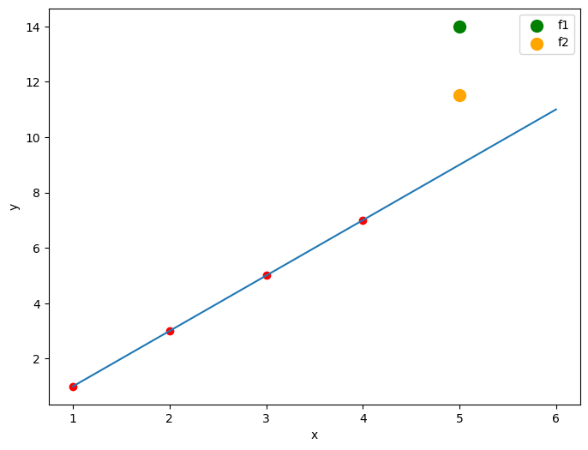

Data points: (1,1), (2,3), (3,5), (4,7) f(5) = ?
$$f_{1}\left(x\right)=\frac{91}{24}x^{4}−{\frac{455}{12}x}^{3}+\frac{3185}{24}x^{2}−\frac{2251}{12}x +90$$
$$f_{1}\left(5\right)=100$$
$$f_{2}\left(x\right)=\frac{41}{24}x^{4}−{\frac{205}{12}x}^{3}+\frac{1435}{24}x^{2}−\frac{1001}{12}x +40$$
$$f_{2}\left(5\right)=50$$
Our intuition : $f\left(5\right)=9$

Slide 3
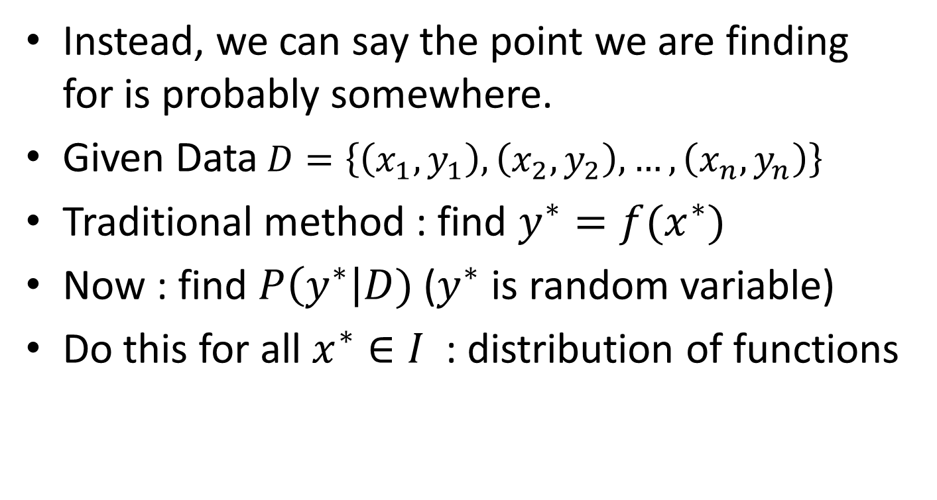
There is no perfect prediction function
Instead, we can say the point we are finding for is probably somewhere.
Given Data$D=\left\{\left(x_{1},y_{1}\right), \left(x_{2}, y_{2}\right), …, \left(x_{n}, y_{n}\right)\right\}$
Traditional method : find $y^{∗}=f(x^{∗})$
Now : find $P\left(y^{∗}\right|D)$ ($y^{∗}$ is random variable)
Do this for all $x^{∗}∈I$ : distribution of functions

Slide 4
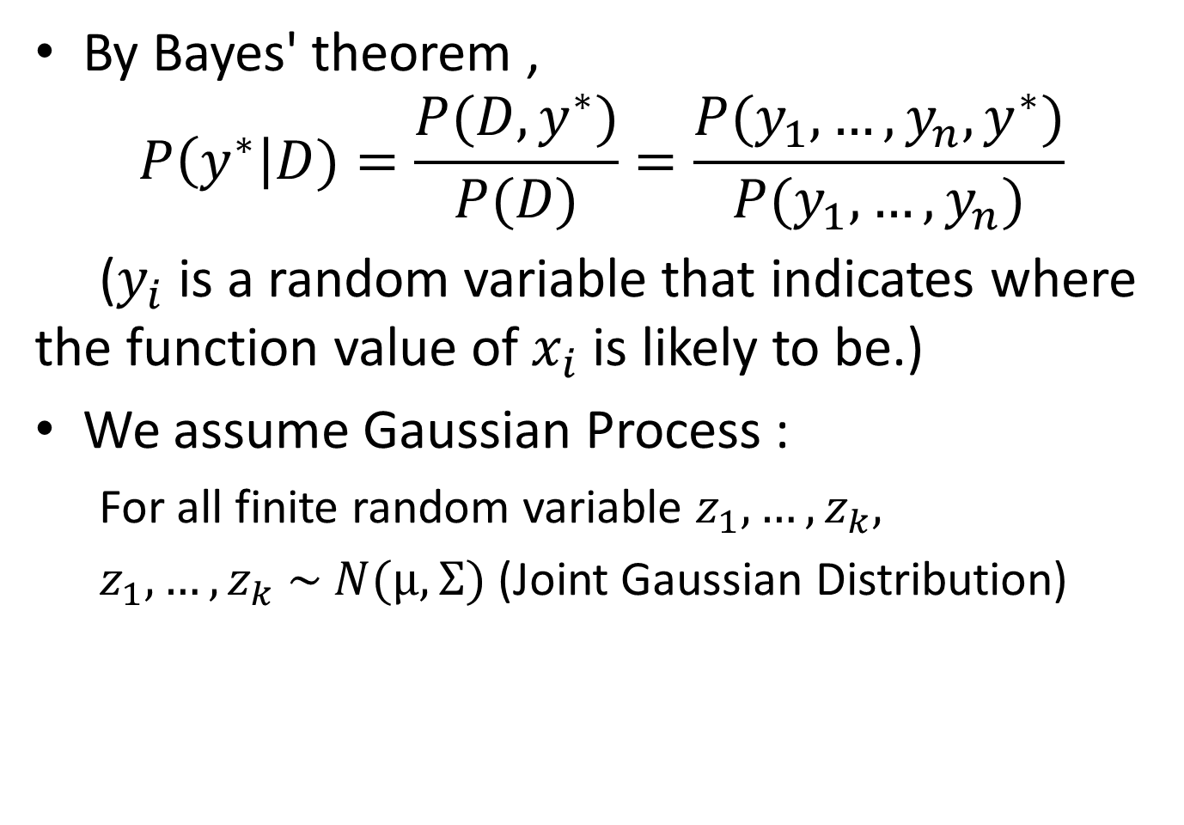
By Bayes' theorem ,
$$P\left(y^{∗}\right|D)=\frac{P(D,y^{∗})}{P(D)}=\frac{P(y_{1}, …,y_{n},y^{∗})}{P(y_{1}, …,y_{n})}$$
($y_{i}$ is a random variable that indicates where the function value of $x_{i}$ is likely to be.)
We assume Gaussian Process :
For all finite random variable $z_{1}, …,z_{k},$
$z_{1}, …,z_{k} \sim N(μ,Σ)$ (Joint Gaussian Distribution)

Slide 5
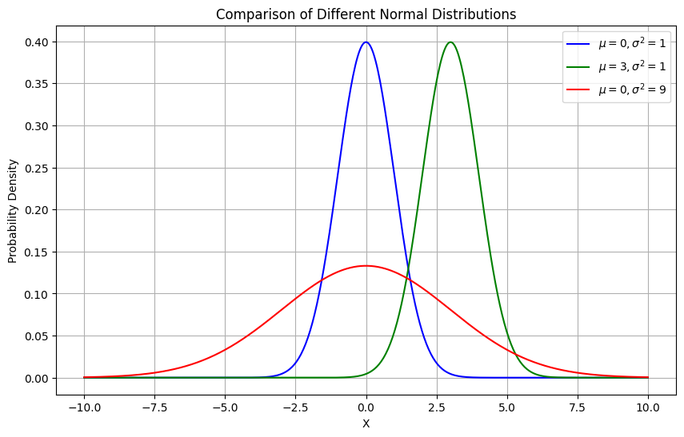

Gaussian (Normal) Distribution
$X \sim N\left(μ,σ^{2}\right) , P\left(X=x\right)=\frac{1}{σ\sqrt{2π}}ⅇ^{−\frac{{\left(x−μ\right)}^{2}}{2σ^{2}}}$

Slide 6
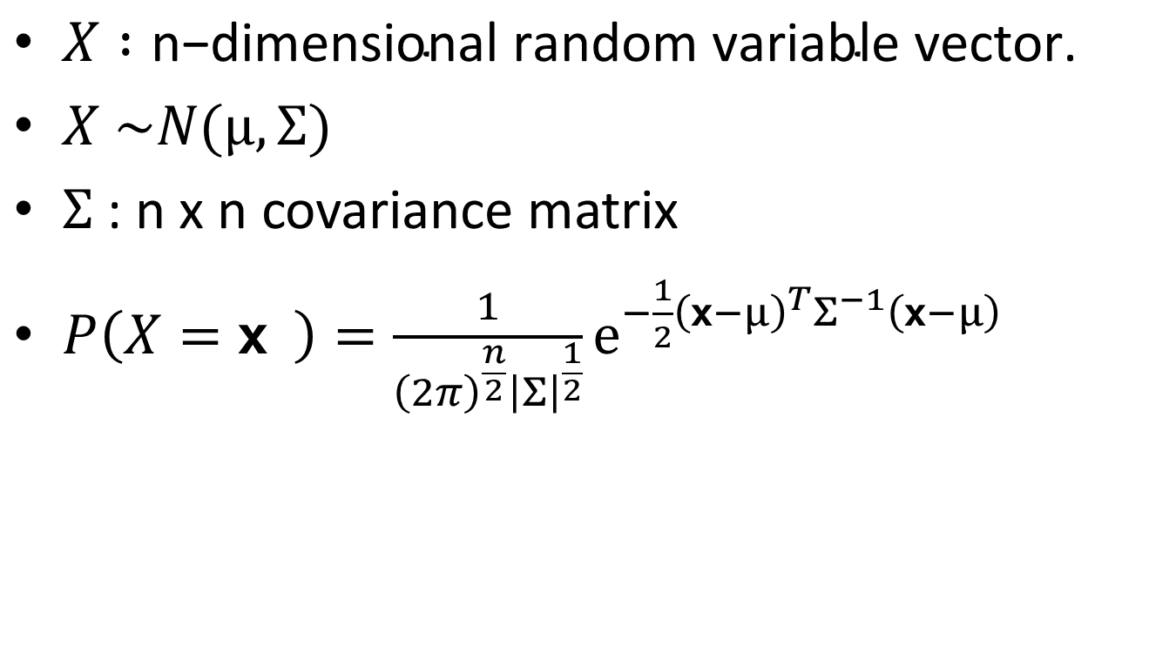
Joint (Multivariate) Gaussian Distribution
$X :\text{n}\text{−}\text{dimensional} \text{random} \text{variable} \text{vector}\text{.}$
$X \sim N(μ,Σ)$
$Σ$ : n x n covariance matrix
$P\left(X=x \right)=\frac{1}{{\left(2π\right)}^{\frac{n}{2}}{\left|Σ\right|}^{\frac{1}{2}}}ⅇ^{−\frac{1}{2}{\left(x−μ\right)}^{T}Σ^{−1}\left(x−μ\right)}$

Slide 7
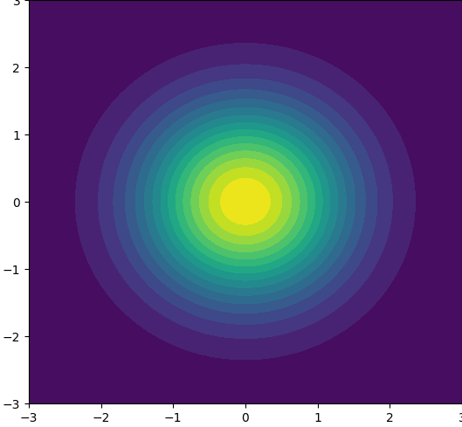
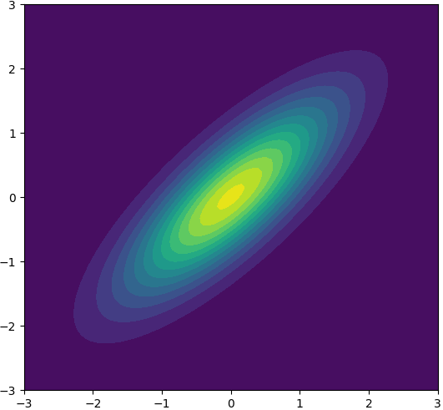
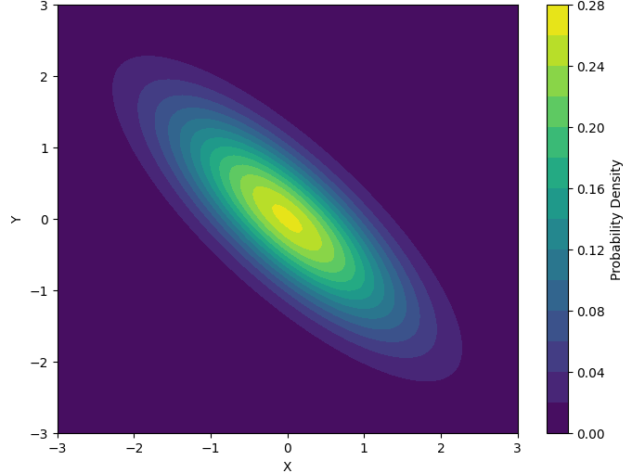
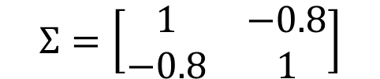
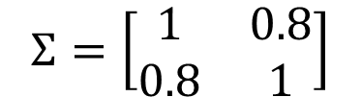
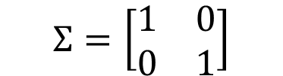
2D Gaussian Distribution
$$Σ=\left[\begin{matrix}1 & 0 \\ 0 & 1\end{matrix}\right]$$
$$Σ=\left[\begin{matrix}1 & 0.8 \\ 0.8 & 1\end{matrix}\right]$$
$$Σ=\left[\begin{matrix}1 & −0.8 \\ −0.8 & 1\end{matrix}\right]$$

Slide 8
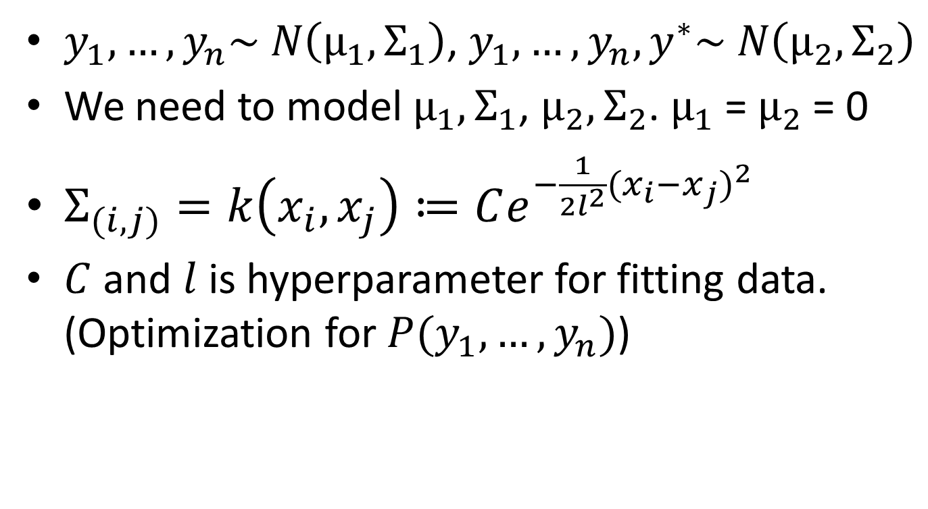
RBF Kernel Function
$y_{1}, …,y_{n}\sim N\left(μ_{1},Σ_{1}\right)$, $y_{1}, …,y_{n},y^{∗}\sim N\left(μ_{2},Σ_{2}\right)$
We need to model $μ_{1},Σ_{1}$, $μ_{2},Σ_{2}$. $μ_{1}$ = $μ_{2}$ = 0
$Σ_{(i,j)}=k\left(x_{i}, x_{j}\right)≔Ce^{−\frac{1}{2l^{2}}{(x_{i}−x_{j})}^{2}}$
$C$ and $l$ is hyperparameter for fitting data. (Optimization for $P(y_{1}, …,y_{n})$)

Slide 9
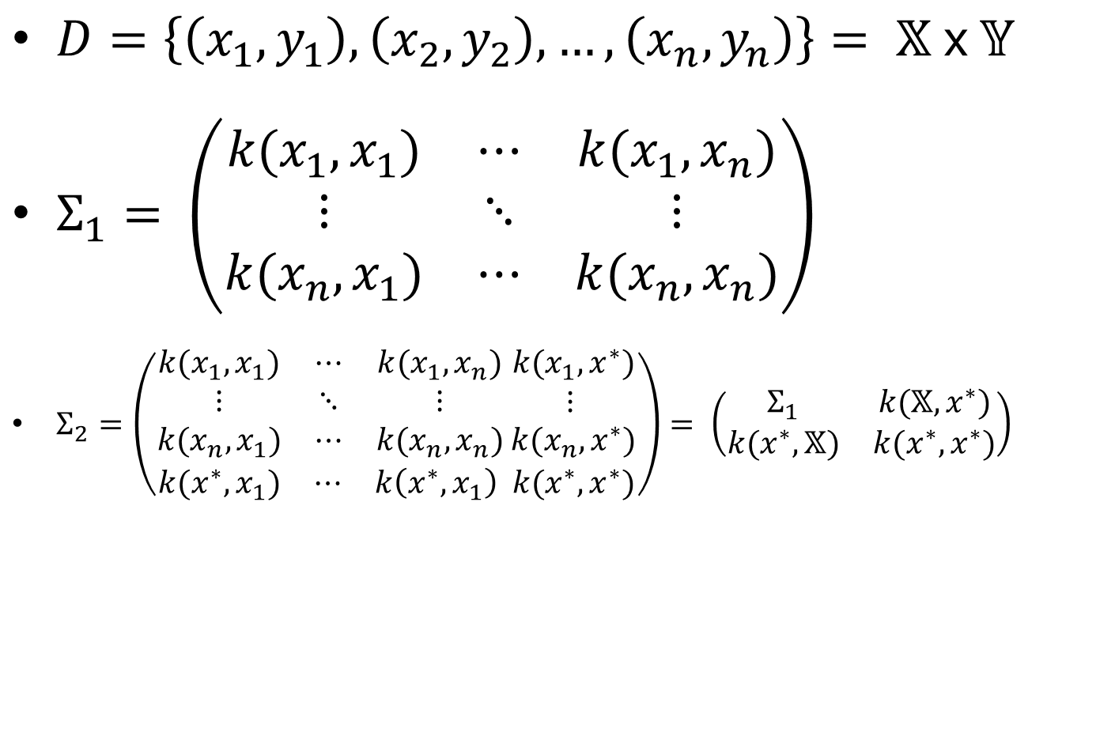
$D=\left\{\left(x_{1},y_{1}\right), \left(x_{2}, y_{2}\right), …, \left(x_{n}, y_{n}\right)\right\}= 𝕏 x 𝕐$
$Σ_{1}= \left(\begin{matrix}k(x_{1}, x_{1}) & ⋯ & k(x_{1}, x_{n}) \\ ⋮ & ⋱ & ⋮ \\ k(x_{n}, x_{1}) & ⋯ & k(x_{n}, x_{n})\end{matrix}\right)$
$Σ_{2}=\left(\begin{aligned}\begin{matrix}k(x_{1}, x_{1}) & ⋯ & k(x_{1}, x_{n}) \\ ⋮ & ⋱ & ⋮ \\ k(x_{n}, x_{1}) & ⋯ & k(x_{n}, x_{n})\end{matrix}\begin{matrix} k(x_{1},x^{∗}) \\ ⋮ \\ k(x_{n},x^{∗})\end{matrix} \\ \begin{matrix}k(x^{∗}, x_{1}) & ⋯ & k\left(x^{∗}, x_{1}\right) k(x^{∗},x^{∗})\end{matrix}\end{aligned}\right)= \left(\begin{matrix}Σ_{1} & k(𝕏,x^{∗}) \\ k(x^{∗},𝕏) & k(x^{∗},x^{∗})\end{matrix}\right)$

Slide 10
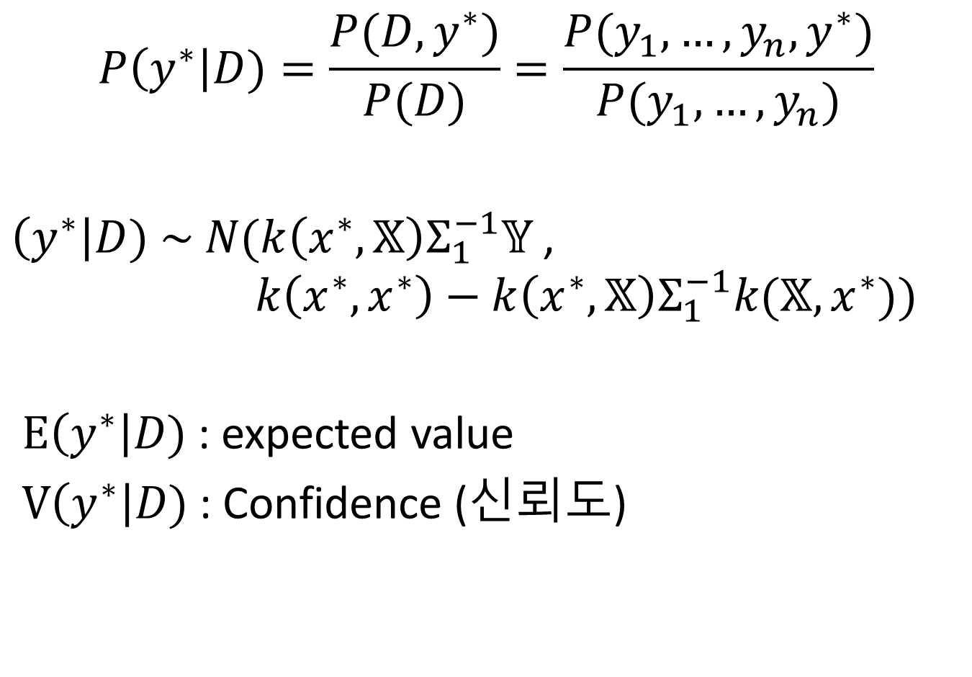
$$P\left(y^{∗}\right|D)=\frac{P(D,y^{∗})}{P(D)}=\frac{P(y_{1}, …,y_{n},y^{∗})}{P(y_{1}, …,y_{n})}$$
$\left(y^{∗}\right|D) \sim N(k\left(x^{∗},𝕏\right)Σ_{1}^{−1}𝕐$,
$$k\left(x^{∗},x^{∗}\right)−{k\left(x^{∗},𝕏\right)Σ}_{1}^{−1}k(𝕏,x^{∗}))$$
$E\left(y^{∗}\right|D)$ : expected value
$V\left(y^{∗}\right|D)$ : Confidence (신뢰도)

Slide 11
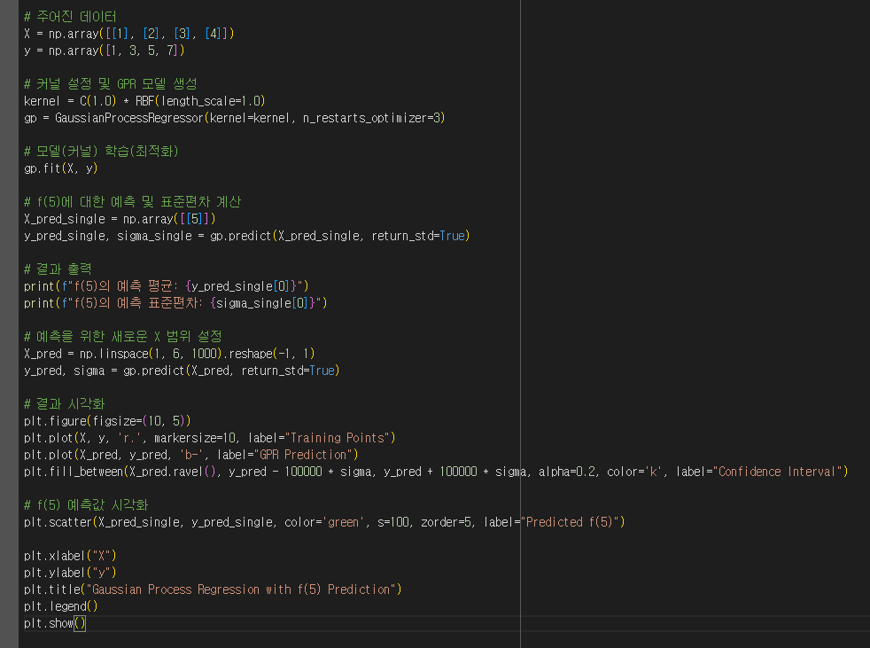
Example.

Slide 12
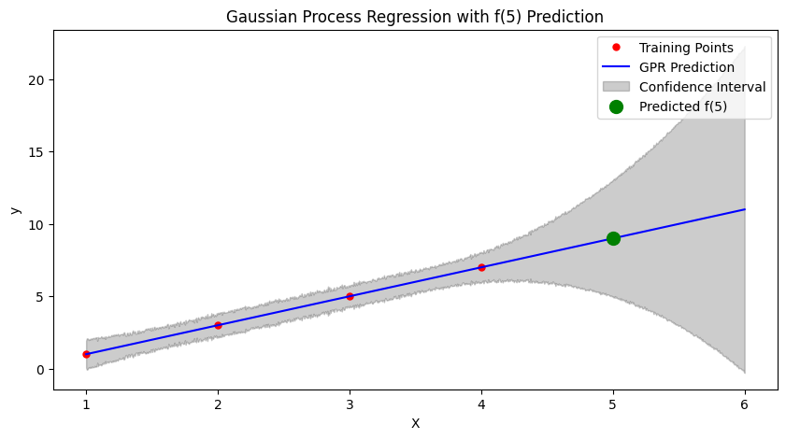

Example.

Slide 13
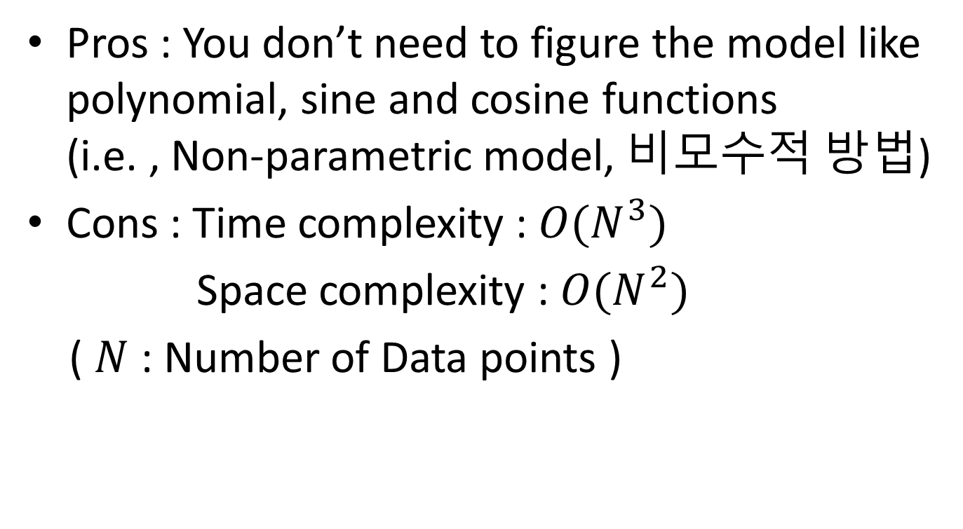
Pros and Cons
Pros : You don’t need to figure the model like polynomial, sine and cosine functions (i.e. , Non-parametric model, 비모수적 방법)
Cons : Time complexity : $O(N^{3})$
Space complexity : $O(N^{2})$
( $N$ : Number of Data points )

Slide 14
Applications

Slide 15
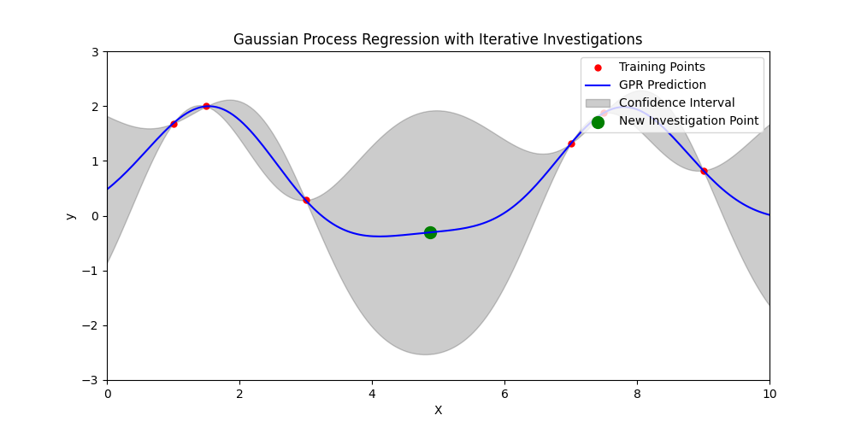
Most efficient data to investigate (minimize error) (Related to Bayesian Optimization)
Select the point with the highest standard deviation

Slide 16
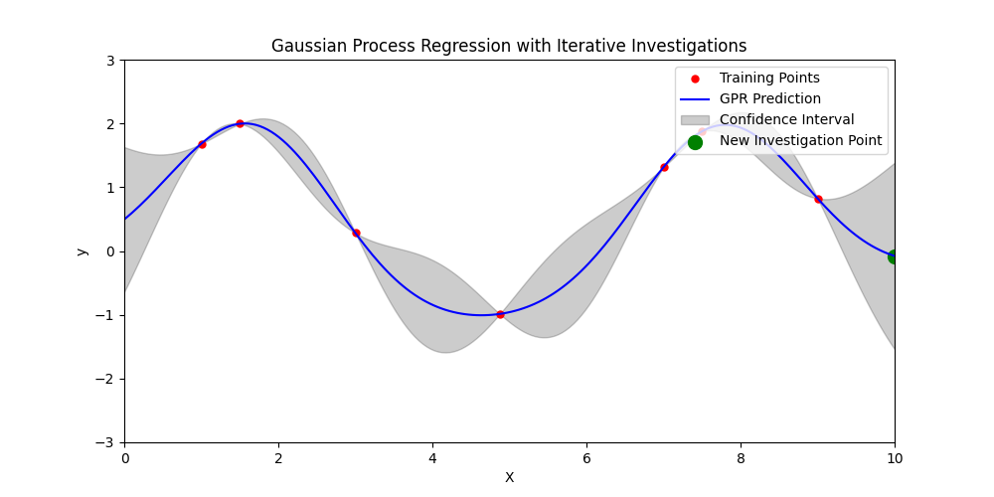

Slide 17
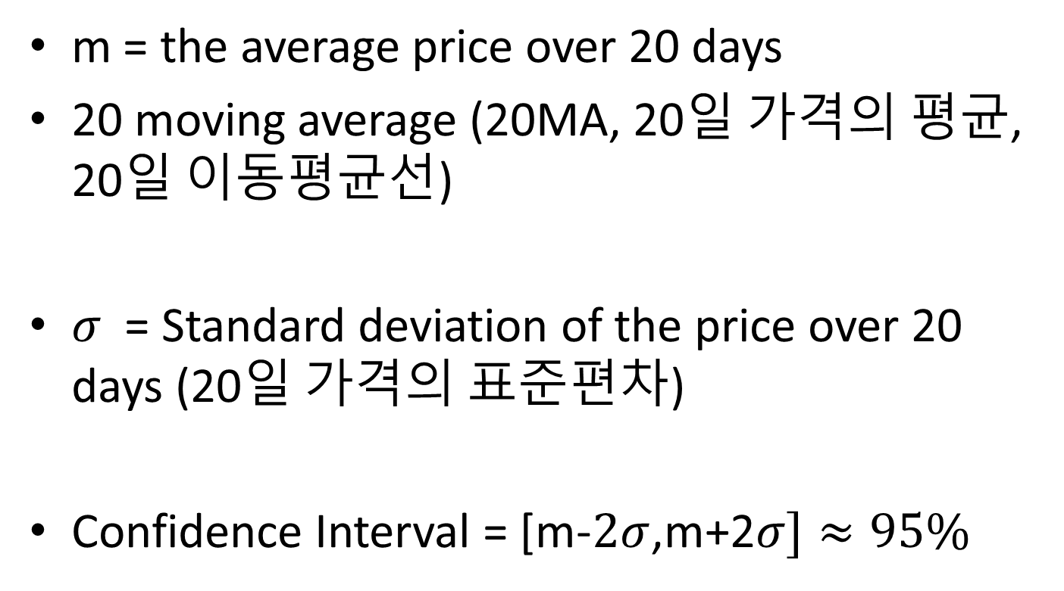
Bollinger Bands for stock chart
m = the average price over 20 days
20 moving average (20MA, 20일 가격의 평균, 20일 이동평균선)
$σ$ = Standard deviation of the price over 20 days (20일 가격의 표준편차)
Confidence Interval = [m-$2σ$,m+2$σ]≈95\%$

Slide 18

Central limit theorem
$\frac{X_{1}+X_{2}+⋯+X_{N}}{N}\sim N\left(μ,Σ\right) as N→∞$
$\frac{X_{1}+X_{2}+⋯+X_{20}}{20}$ is close enough to $N\left(μ,Σ\right)$.

Slide 19
